Slide 1
introduction.
Week 1 | Lecture 1 (1.1)

Slide 2
This Week’s Content
Lecture 1.1
Introduction
Lecture 1.2
Variables, Expressions, and Operators
Reading: Chapters 1, 2, 3
Lecture 1.3
The Programming Process

Slide 3
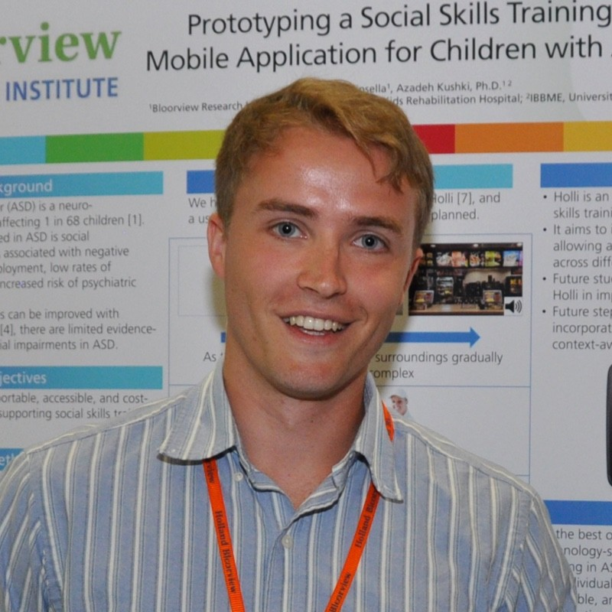


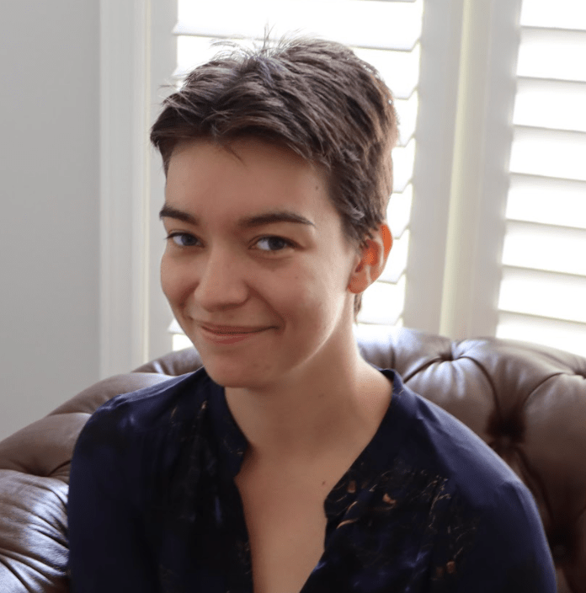
Teaching Team
Ben
Instructor
Seb
Instructor
Joseph
TA
Katia
TA

Slide 4
Ben
Bachelor of Electrical & Biomedical Engineering @ McMaster University 2015
Realized the power of programming (and how it can be used for good, not evil)
Master of Biomedical Engineering @ University of Toronto 2020
Hold up… people will pay me for ‘playing’ on my computer?
In between obtaining degrees I spent time programming a few different projects…

Slide 5
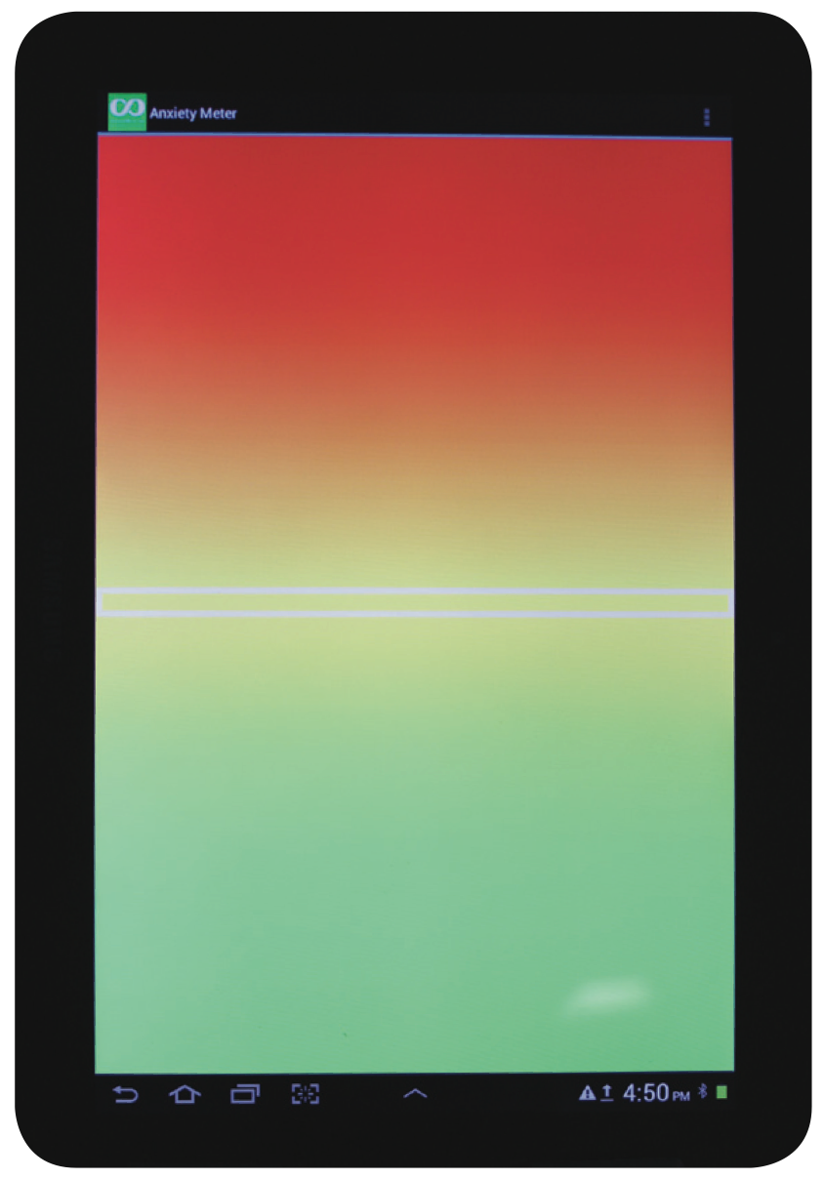


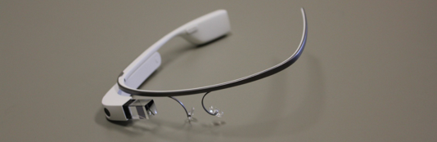

Projects for children with autism spectrum disorder
Hi!

Slide 6
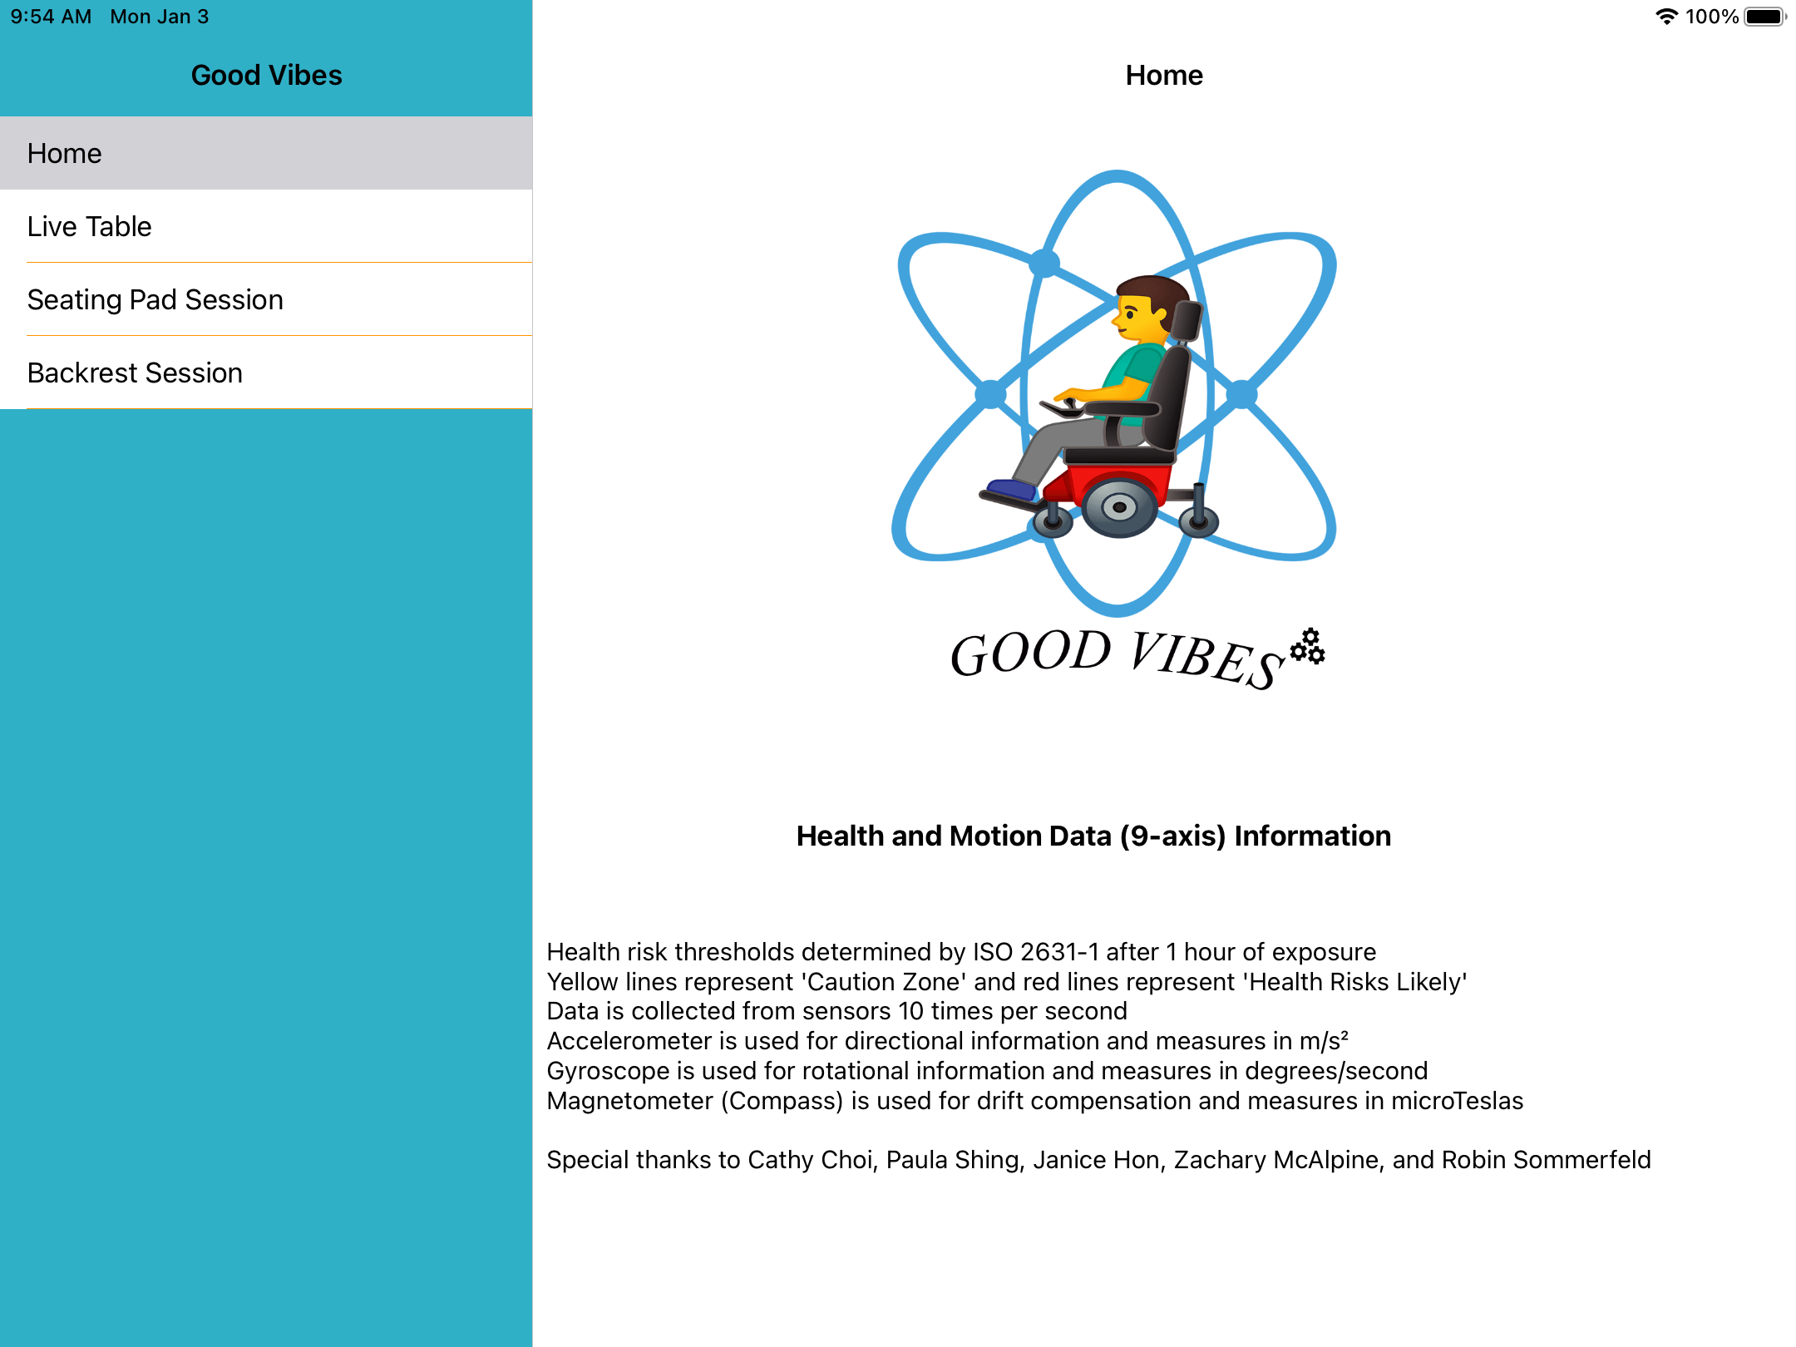
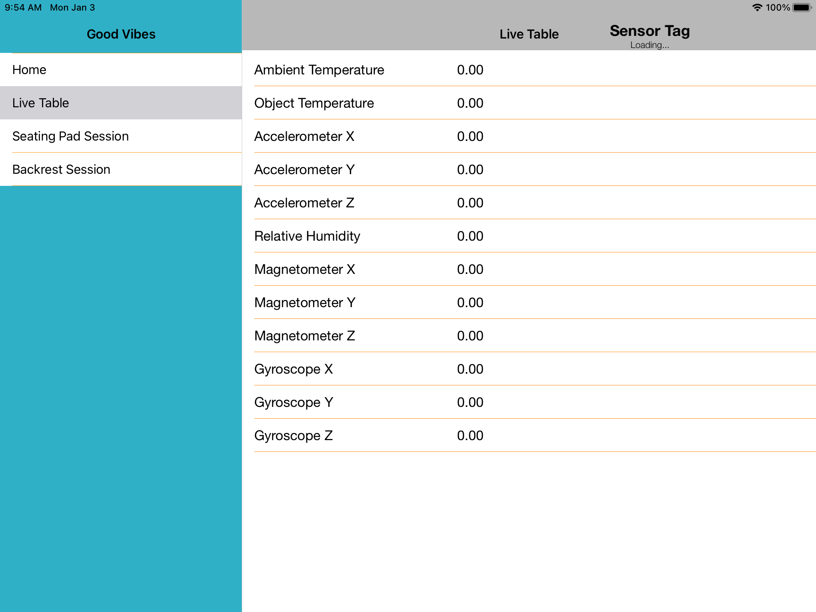
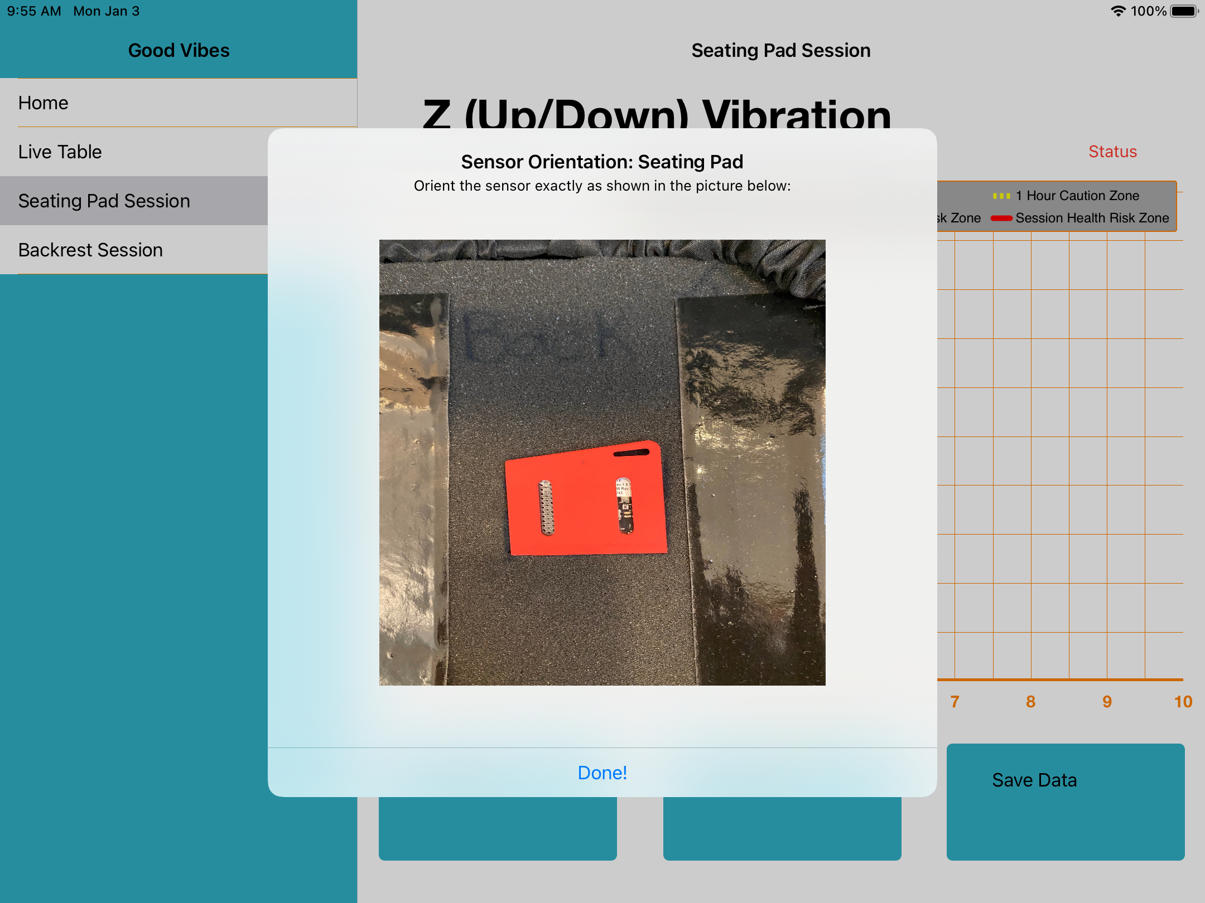
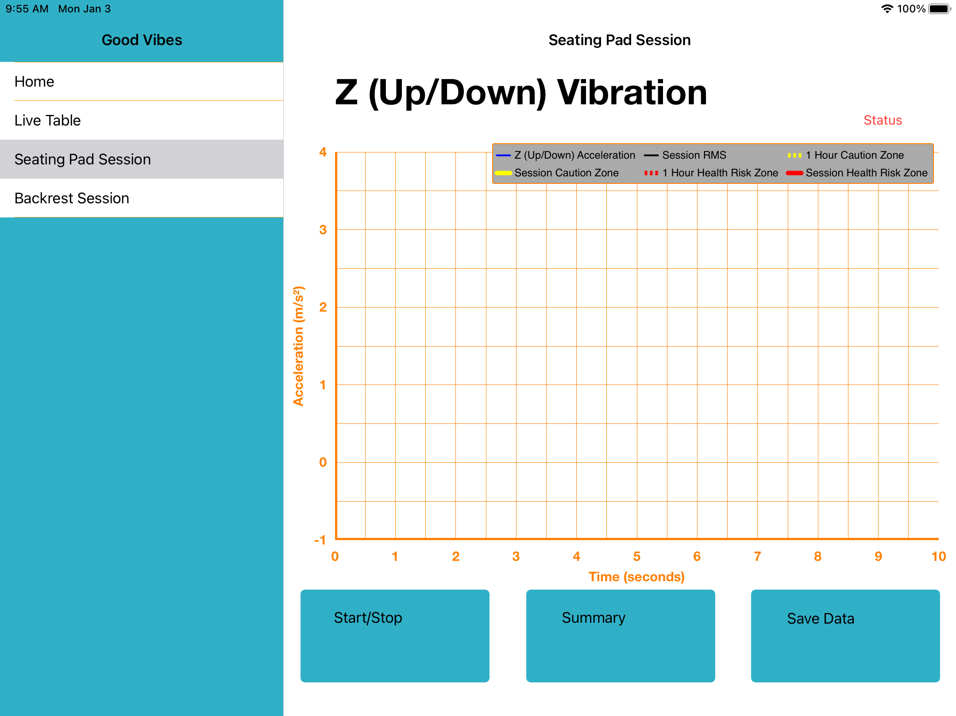


Good Vibes A wheelchair vibration measurement tool

Slide 7
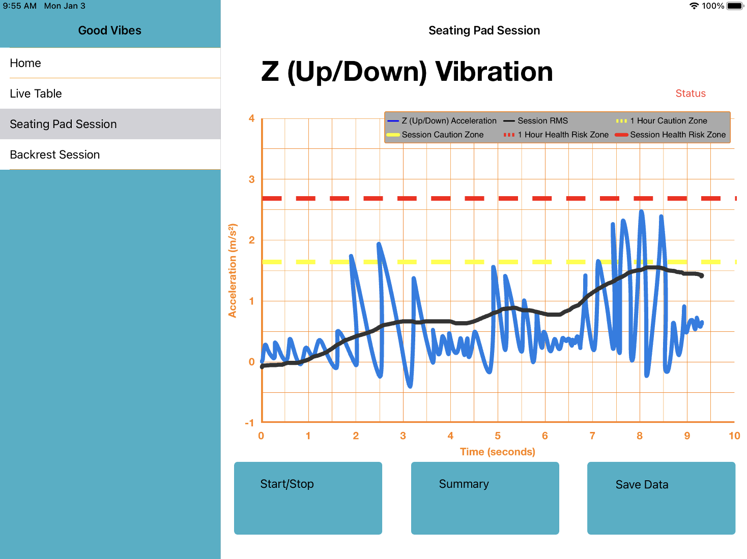

Slide 8

More about Ben…

Slide 9



Seb
Completed CivMin PhD in 2014 where I studies rock fracture and seismology (RFDF).
AI Lead at KORE Geosystems, a mining tech startup.
Senior Research Scientist at SickKids.
Joined UofT CivMin in January 2020.
Research topics: rock mechanics, ultrasonics, signal processing, computer vision, applied machine learning in mining.

Slide 10

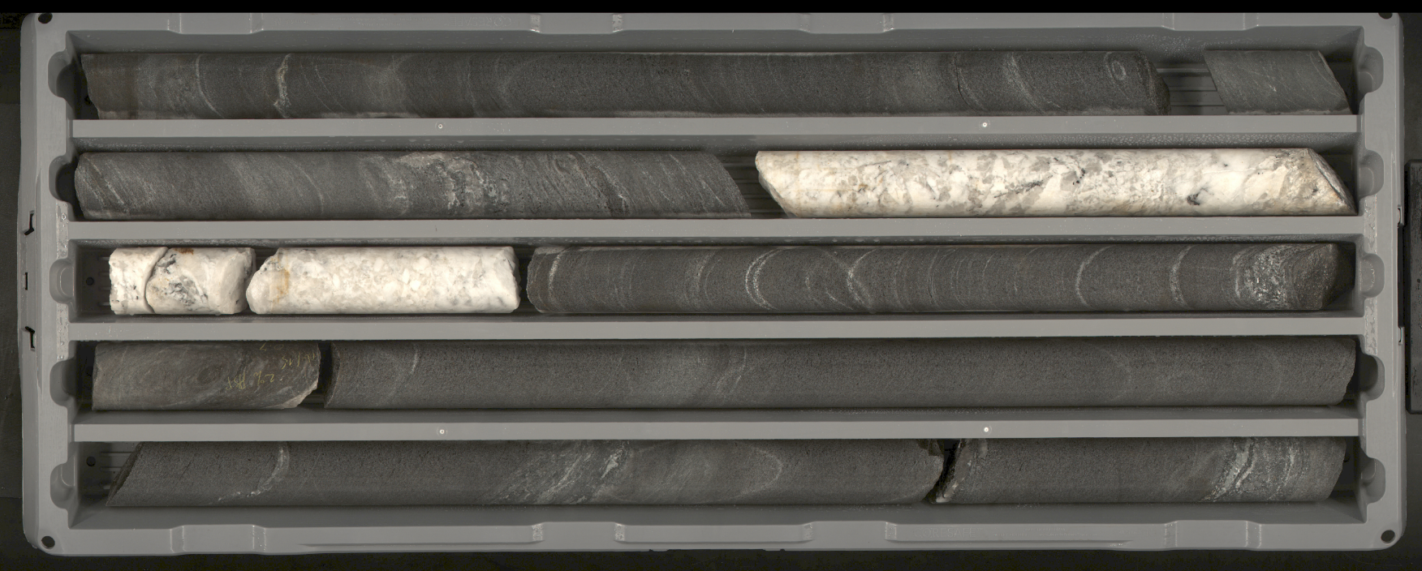
AI 4 Mining
At KORE,
I use code to do this!
Mining companies drill thousands of meters every year and the recovered rock (core) needs to be visually described by humans.

Slide 11
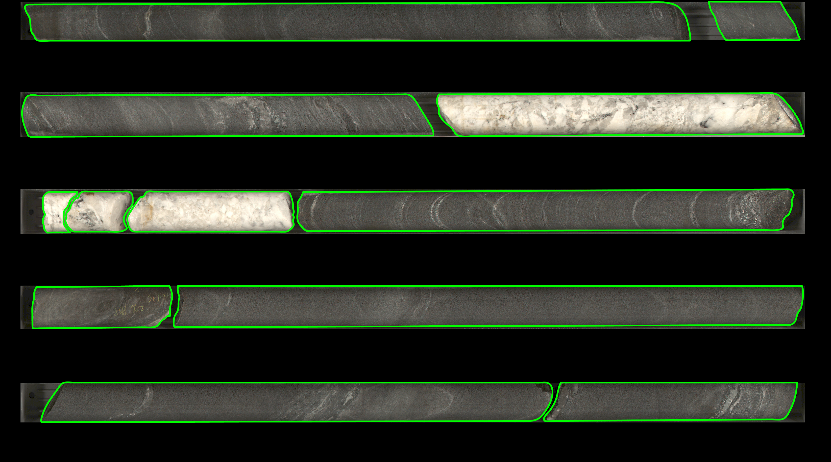
AI 4 Mining
At KORE,
I use code to do this!

Slide 12
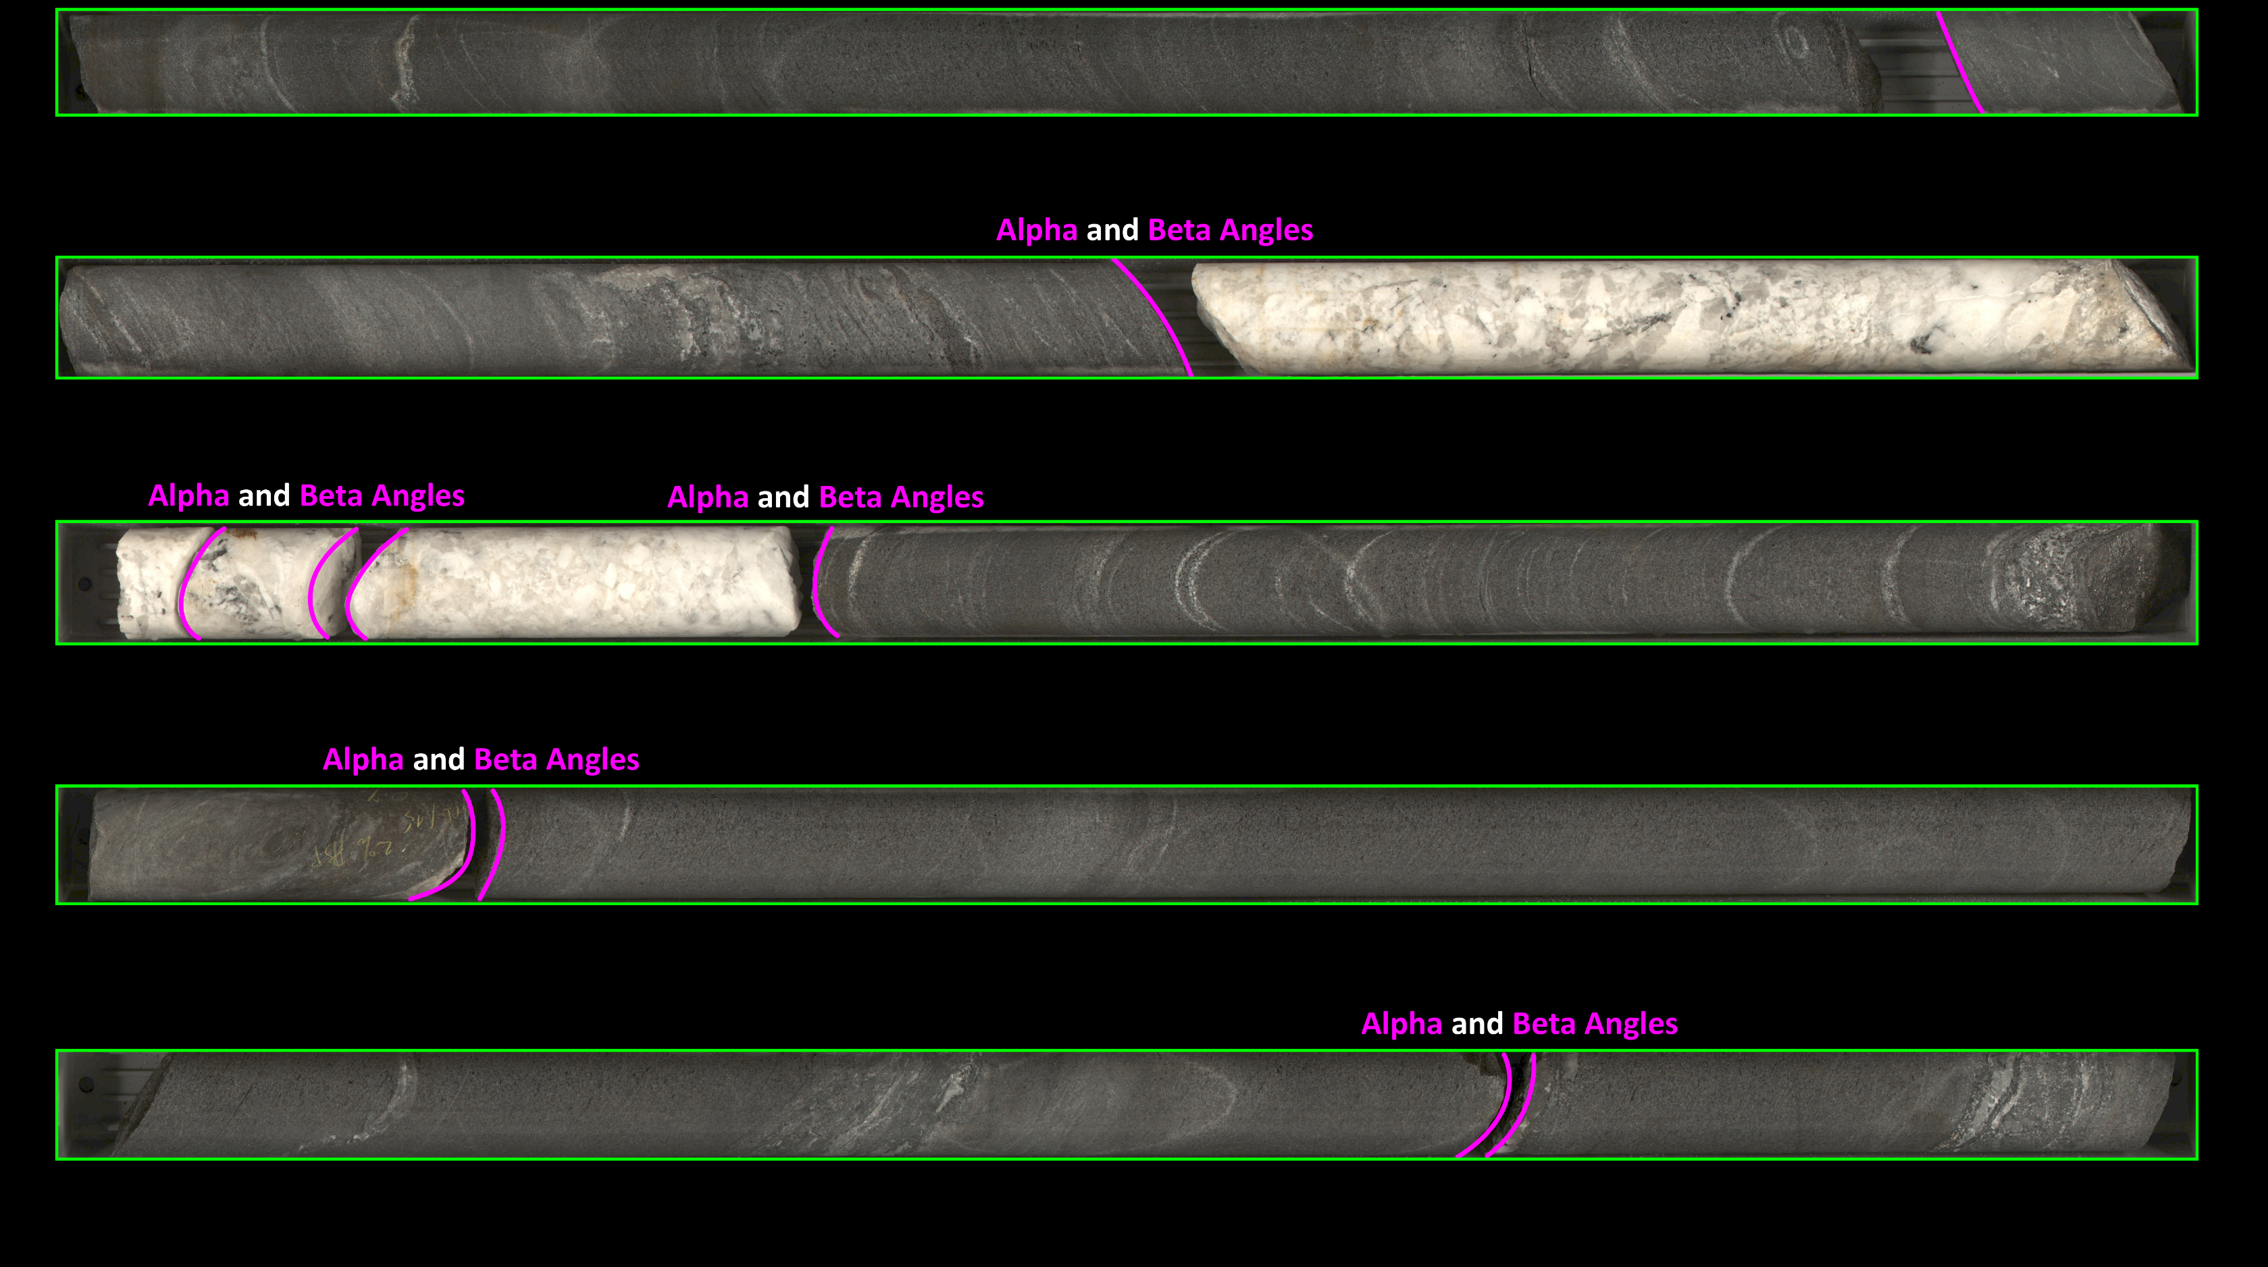
AI 4 Mining
At KORE,
I use code to do this!

Slide 13
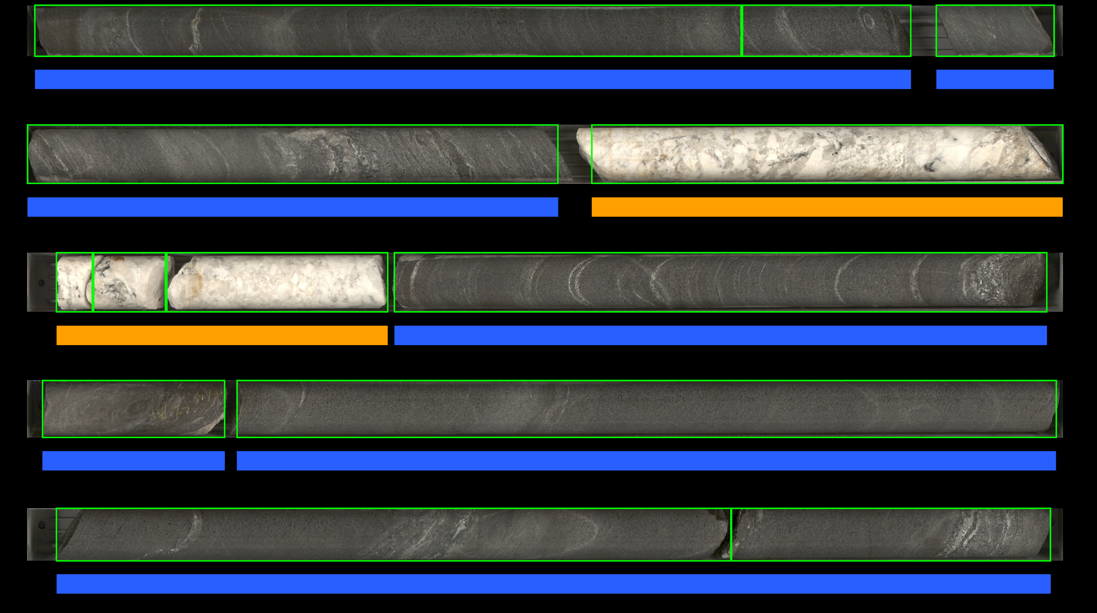
AI 4 Mining
At KORE,
I use code to do this!

Slide 14



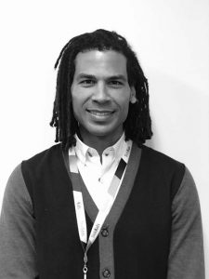


AI 4 Healthcare
AI Diagnosis
JET 98%
AI
Detects
JET
Pages
Mjaye
At SickKids,
I use code to do this!
Staff Physician
Nurse
Confirm
12-Lead
JET
Onset
5 minutes later
Treatment begins
AI

Slide 15

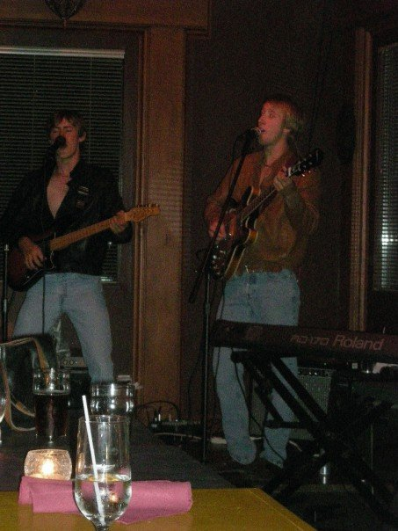
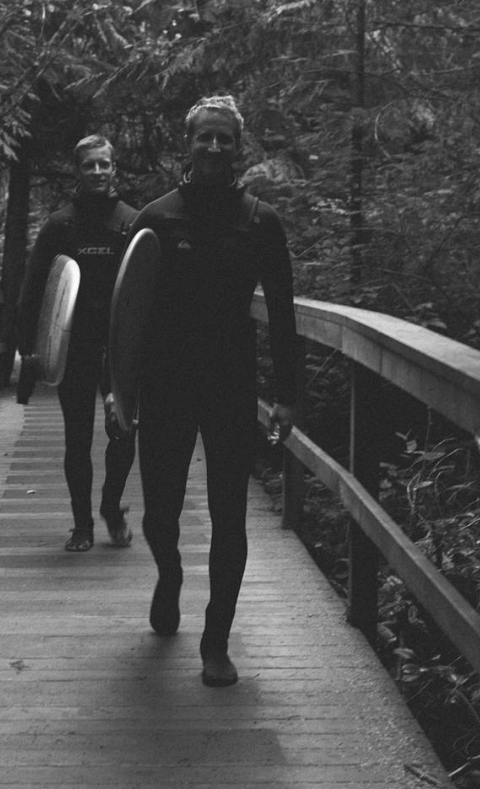



Seb
I love travelling and have visited over 20 countries including France, Switzerland, Italy, Austria, Croatia, Costa Rica, Nicaragua, Panama, Peru, Bolivia, United States, Israel, Jordan, West Bank, Egypt, Turkey, Morocco, South Africa, and Namibia.
I was a founding member of Ottawa’s premiere Beatles cover band.
I love camping, hiking, and surfing.
I have a wonderful baby boy named Avery Goodfellow and baby girl name August.
I love building things with code ( Github: Seb-Good).

Slide 16
Katia
Doing a Master's in Civil Engineering.​
Worked as a software application engineer-in-training (EIT) for 3.5 years.​
Working with Python to analyze and clean data!
Using Python to work with images from digital and optical microscopes of concrete and other building materials. As well, analyzing fracture behavior from Finite Discrete Element simulation models (FDEM).​
Martial arts fanatic :) involved in both Muay Thai and karate. ​
Also play piano, working towards Royal Conservatory certification.

Slide 17
Joseph
Doing a PhD in biomedical engineering.
A marathon runner and currently training for a triathlon.
Interweaves Python and MATLAB to analyze ultrasound wave propagation in artificial hearts made from stem cells through image and signal analysis.

Slide 18

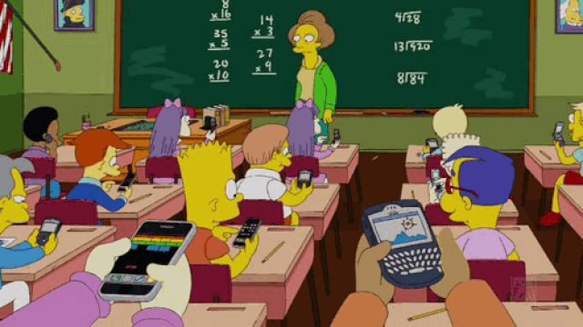
In Person (hopefully ☹)
Talking
Cell Phones
Eating
Being Late for Lectures

Slide 19


In Person (hopefully ☹)
Talking
Cell Phones
Eating
Being Late for Lectures

Slide 20
Online
Ask questions in the chat or raise your hand if you’d like to unmute yourself to ask a question.
Answer other students’ questions if you think you know the answer
Never forget - if you have a question, there’s always other people in the room wondering the same thing. They will be happy you asked it!

Slide 21
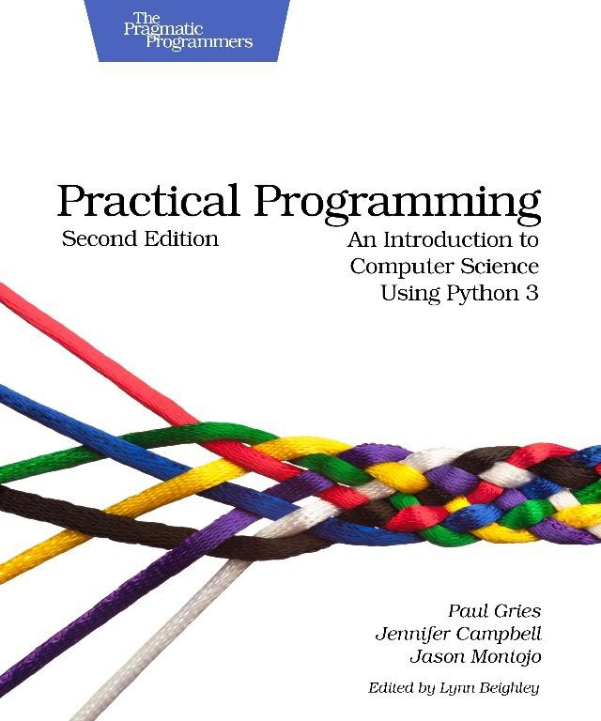
Course Information
Quercus:
APS106H1 S LEC0101 (One site contains all information).
Textbook:
Practical Programming: An Introduction to Computer Science Using Python 3, 2nd edition, Paul Gries, Jennifer Campbell, Jason Montojo, Pragmatic Programmers.
Piazza:
piazza.com/utoronto.ca/winter2019/aps106
Print $38 (e-book $25)

Slide 22
Grading
Labs (9 in total)
Midterm Test (s)
Final Exam
total: 10%
total: 40%
total: 50%
Petitions: First-year Office.

Slide 23
Lecture Schedule
Section | Monday | Tuesday | Wednesday | Thursday | Friday
LEC01 & LEC02 |  | 15:00-16:00 |  | 15:00-16:00 | 15:00-16:00
Lectures will be online until Jan 31 when we will (hopefully) transition to in person in MYHAL 150.
Microsoft Teams links for lectures can be found on Quercus.
Lecture content can be found on Quercus using the Kinsella & Goodfellow link.

Slide 24
Tutorial Schedule
Tutorials will be online until Jan 31 when we will (hopefully) transition to in person.
Zoom links for tutorials can be found on Quercus.
Week | Tut Content | Monday | Tuesday | Wednesday | Thursday | Friday
Week 1 (Jan 10 - Jan 14) | No Tutorial
Week 2 (Jan 17 - Jan 21) | Tutorial 1 | TUT0104 11:00-12:00 MY 380 | TUT0106 10:00-11:00 WB 130 TUT0107 11:00-12:00 GB 303 TUT0108 15:00-16:00 SS 1087 | TUT0102 12:00-13:00 MY 380 TUT0105 16:00-17:00 MY 380 |  | TUT0101 09:00-10:00 GB 304 TUT0103 13:00-14:00 WB 130
Click here for content.

Slide 25
Lab Schedule
Labs will be online until Jan 31 when we will (hopefully) transition to in person.
Zoom links for labs can be found on Quercus.
Week | Lab Content | Monday | Tuesday | Wednesday | Thursday | Friday
Week 1 (Jan 10 - Jan 14) | No Lab |  |  | Lab 1 Released 18:00
Week 2 (Jan 17 - Jan 21) | Lab 1 | PR0106 09:00-11:00 MY 030 PR0108 09:00-11:00 GB 144 | PR0107 09:00-11:00 MY 030 PR0102 16:00-18:00 GB 144 | PR0104 09:00-11:00 GB 150 PR0103 13:00-15:00 GB 144 PR0101 16:00-18:00 GB 144 Lab 2 Released 18:00 | Lab 1 Due 23:00 | PR0105 11:00-13:00 WB 255
Click here for content.

Slide 26
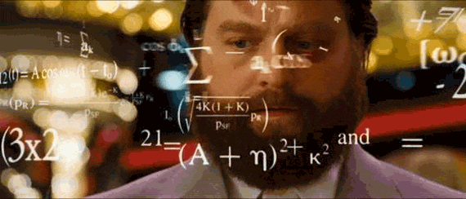
Tips for Success
Do not wait until the last minute.
Work Together (except during the test/exam):
Synthesis
Application
Evaluation
Explanation
Work Smart (effort doesn’t necessarily equal progress).
Time Management.
Know when (and how) to ask for help.

Slide 27
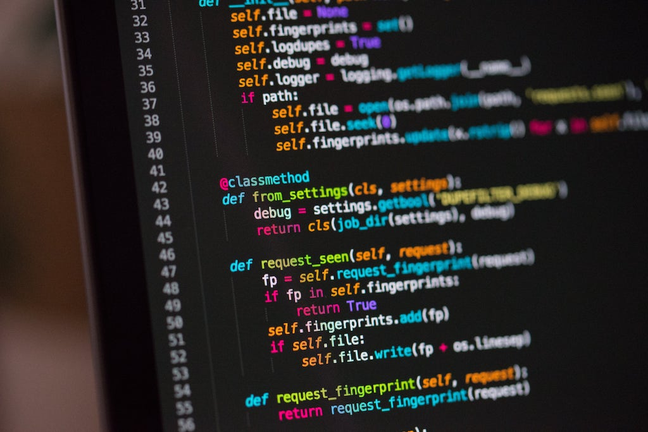
What is this course all about?
Learn the fundamentals of programming.
Programming as a tool used in engineering.
Engineering design through programming.

Slide 28
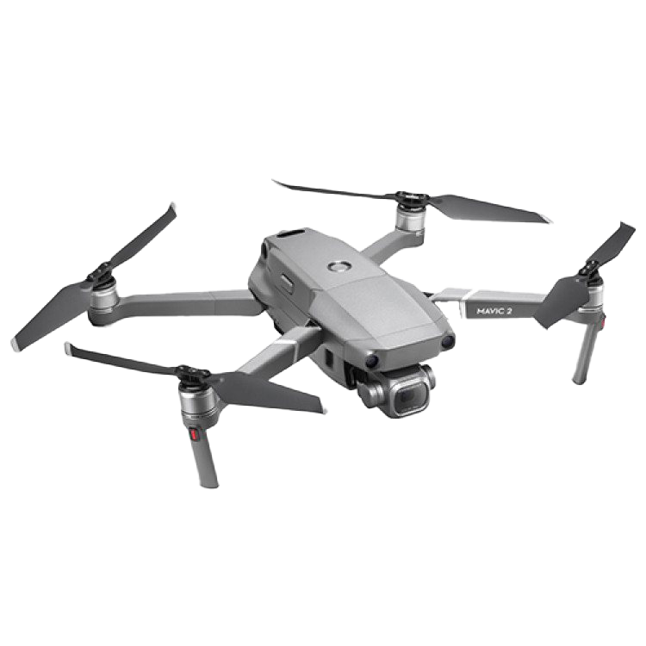

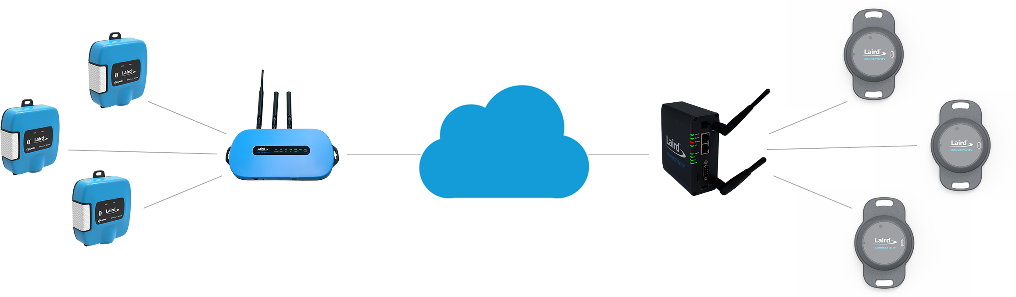

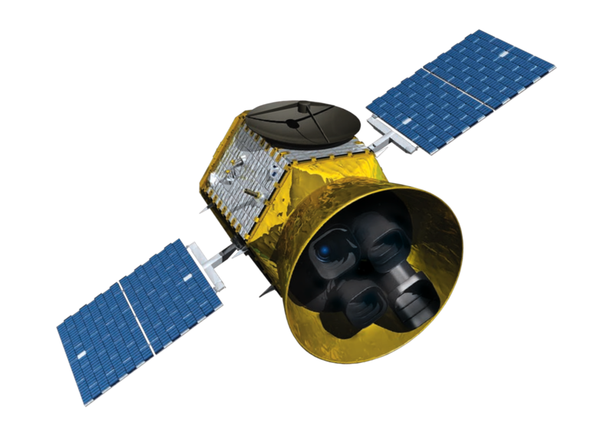
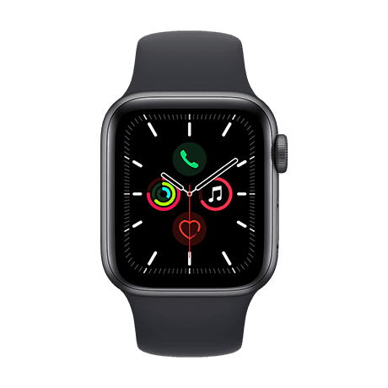
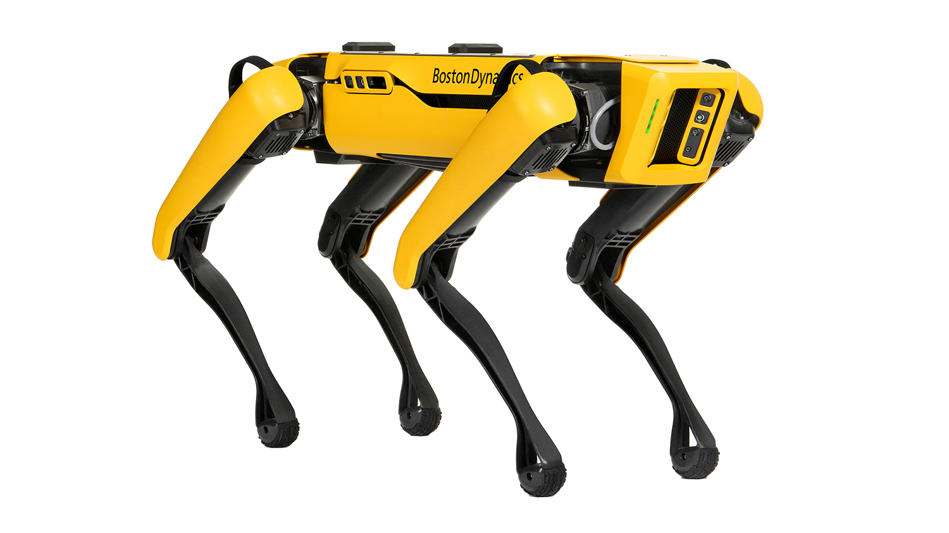
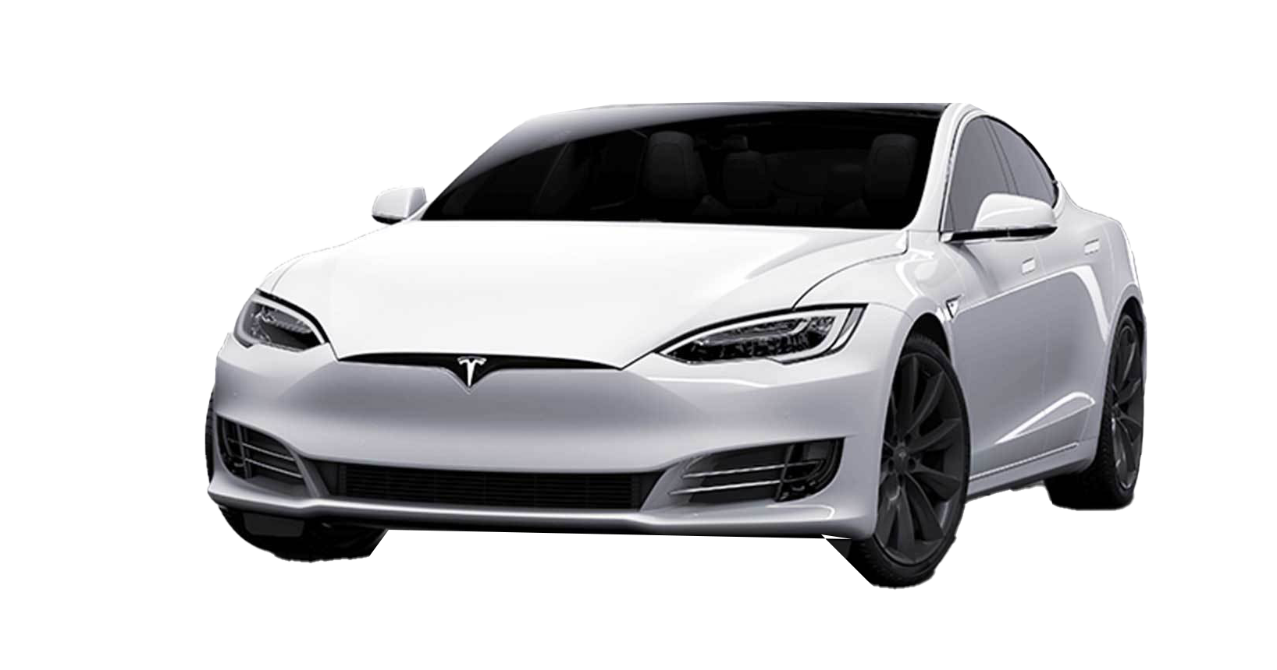
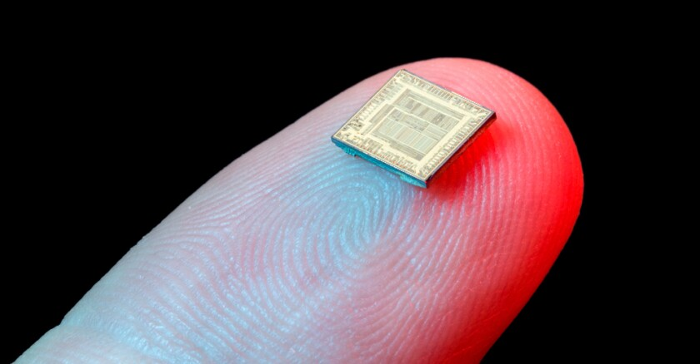
Why Programming?

Slide 29

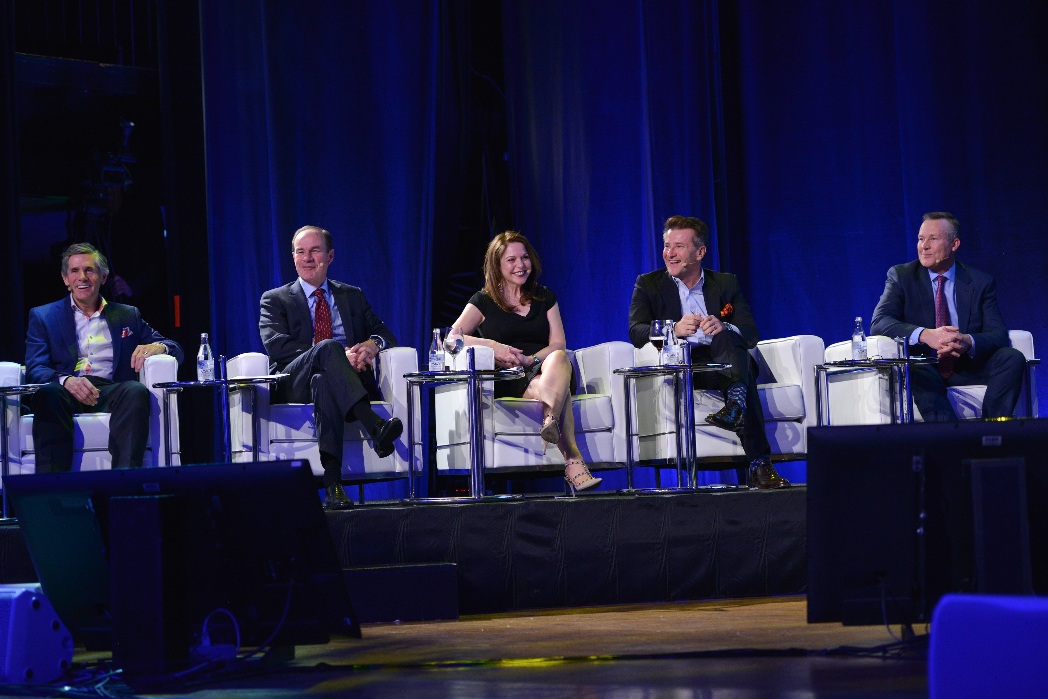
Why Programming?
Computers are everywhere:
Learn to interact with them.
Simplifies our jobs.
Entrepreneurial opportunities ($$$).
Necessary for engineering jobs.
Research and development.
Because it’s fun!
$1,000,000 Investment.
Owner of McEwen Mining Inc.
President of Cisco Systems Canada
COO of Goldcorp
CEO of Franco-Nevada Corporation
SHARK on ABC’s Shark Tank

Slide 30
What is Programming?
A way of telling a computer what to do.
A computer can’t infer (…yet).
Need to tell a computer every single step it needs to do in a language it can understand.
How would you request an egg for breakfast to a chef and to a computer/robot?
To a Chef
Sunny-side up, please!
To a Computer
“Turn on stove”
“Take out pan”
“Take one egg out of fridge”
“Crack egg”
“Pour egg into pan”
“Wait 5 minutes”

Slide 31
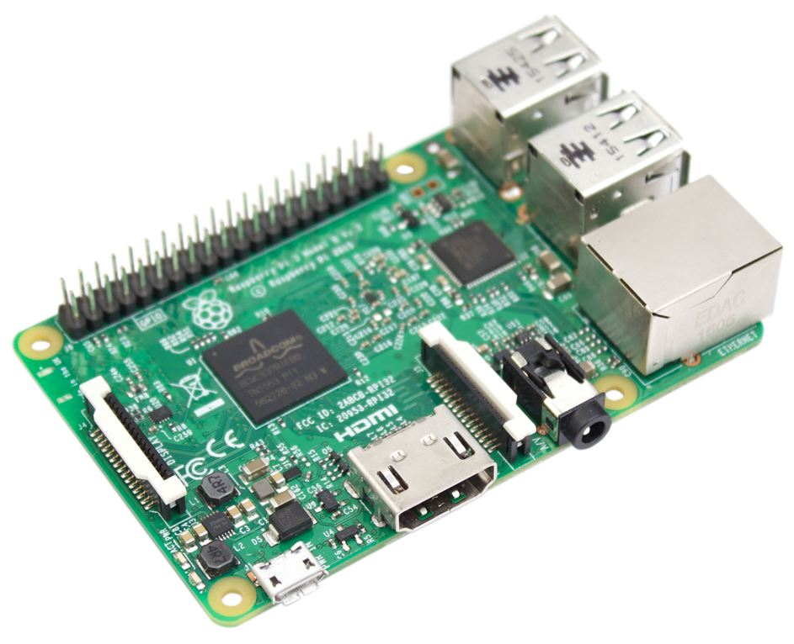
Programmer
English
How to Program a Computer.
Pseudocode
Programing Language
Compiler
Assembly Code
Assembler
Machine Code
Hardware

Slide 32
Why Python?
High-level language making it more like a readable, human language than other low-level languages.
Simple and clear syntax.
Large open-source community.
Used by Google, Firefox, Dropbox, Youtube, Instagram, Yelp, NASA, CIA, etc.
The Artificial Intelligence (AI) community overwhelmingly uses Python.

Slide 33


Why Python?
Lower-Level
High-level language making it more like a readable, human language than other low-level languages.
Simple and clear syntax.
Large open-source community.
Used by Google, Firefox, Dropbox, Youtube, Instagram, Yelp, NASA, CIA, etc.
The Artificial Intelligence (AI) community overwhelmingly uses Python.
public class HelloWorld
{
public static void main(String[ ] args)
{
system.out.println(“Hello World!”);
}
}
Higher-Level
print(“Hello World!”)

Slide 34
Why Python?
Increasing Program Size
Matlab, SQL
C++, Java, Python
High-level language making it more like a readable, human language than other low-level languages.
Simple and clear syntax.
Large open-source community.
Used by Google, Firefox, Dropbox, Youtube, Instagram, Yelp, NASA, CIA, etc.
The Artificial Intelligence (AI) community overwhelmingly uses Python.
C, Fortran, Pascal
Assembly Code
Machine Code
Hardware
Increasing
Ease-of-Use

Slide 35
Why Python?
High-level language making it more like a readable, human language than other low-level languages.
Simple and clear syntax.
Large open-source community.
Used by Google, Firefox, Dropbox, Youtube, Instagram, Yelp, NASA, CIA, etc.
The Artificial Intelligence (AI) community overwhelmingly uses Python.
if x > 10:
print(“x is greater than 10”)
You don’t know Python.
Can you figure out what this code does?

Slide 36
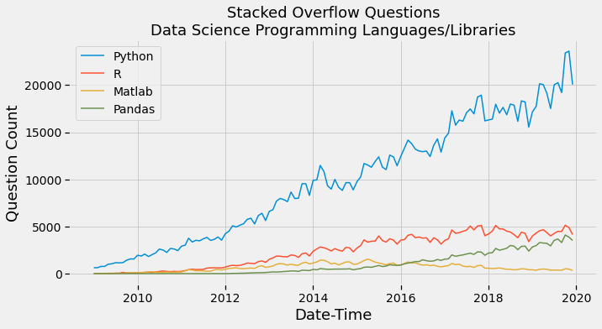
Why Python?
High-level language making it more like a readable, human language than other low-level languages.
Simple and clear syntax.
Large open-source community.
Used by Google, Firefox, Dropbox, Youtube, Instagram, Yelp, NASA, CIA, etc.
The Artificial Intelligence (AI) community overwhelmingly uses Python.

Slide 37









Why Python?
High-level language making it more like a readable, human language than other low-level languages.
Simple and clear syntax.
Large open-source community.
Used by Google, Firefox, Dropbox, Youtube, Instagram, Yelp, NASA, CIA, etc.
The Artificial Intelligence (AI) community overwhelmingly uses Python.

Slide 38










Why Python?
High-level language making it more like a readable, human language than other low-level languages.
Simple and clear syntax.
Large open-source community.
Used by Google, Firefox, Dropbox, Youtube, Instagram, Yelp, NASA, CIA, etc.
The Artificial Intelligence (AI) community overwhelmingly uses Python.

Slide 39
Why Python?
High-level language making it more like a readable, human language than other low-level languages.
Simple and clear syntax.
Large open-source community.
Used by Google, Firefox, Dropbox, Youtube, Instagram, Yelp, NASA, CIA, etc.
The Artificial Intelligence (AI) community overwhelmingly uses Python.

Slide 40

Why Engineers?
Ok, so we’ve explained why coding is important and why we’re learning to code in Python.
BUT, you’re all engineers, right?
Mechanical
Materials
Civil
Chemical
Mineral
Why do these kinds of engineers need to know how to code?

Slide 41
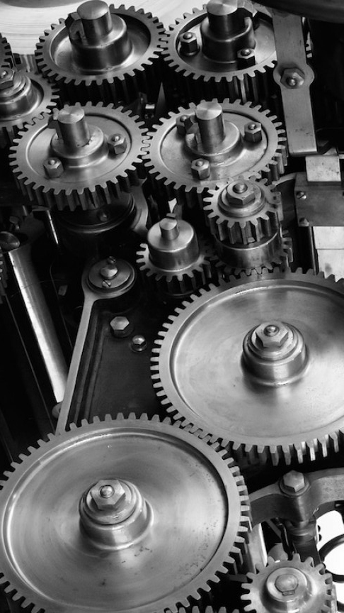
Mechanical Engineers
Design Airplanes
Micro Fluid Systems
Automotive Engines
Hydraulic Dams

Slide 42
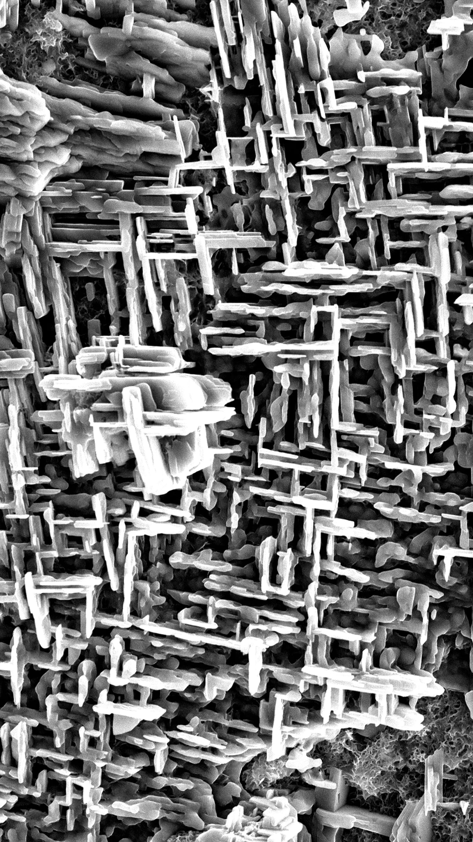
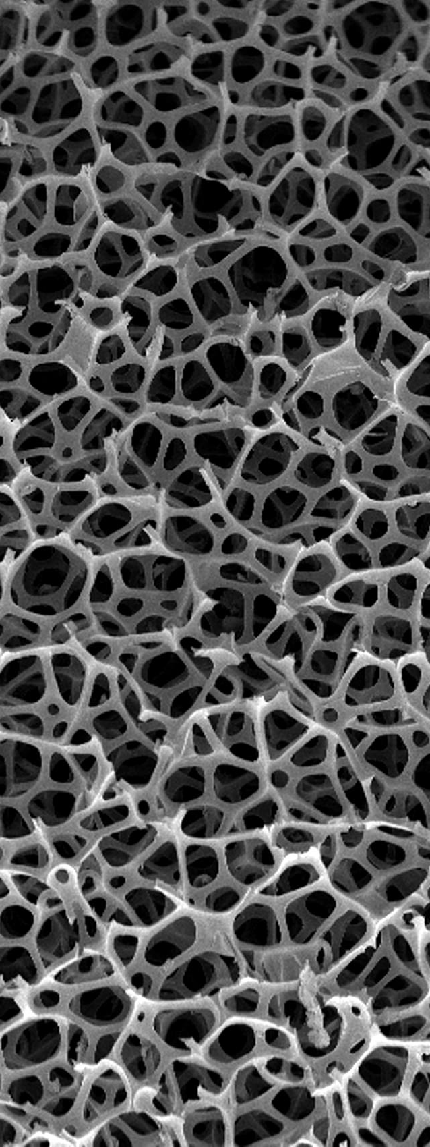
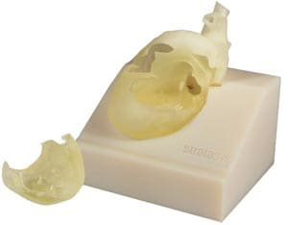
Materials Engineers
Biomaterials
Design of Materials
Manufacturing with Materials
Sustainable Materials Processing

Slide 43

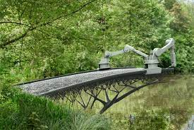
Civil Engineers
Design Buildings
Test Concrete
Manage Water Supply System
Design Bridges

Slide 44

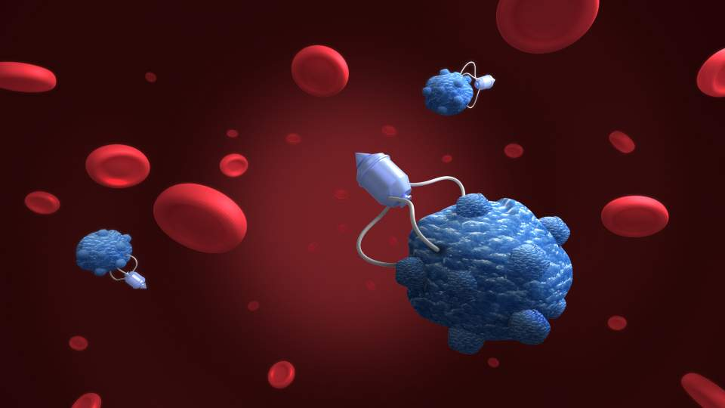
Chemical Engineers
Chemical Manufacturing Processes
Petroleum Extraction
Nanotechnology
Manufacturing Computer Components

Slide 45

Mineral Engineers
Mine Design
Mineral Processing
Mineral Exploration
Mining Finance
Mineral Extraction

Slide 46
Why Engineers?
Again, why do engineers need to know how to code?
In the 20th century, engineers didn’t need to know how to code.
In the 21th century, coding is an essential skill and any engineer without solid coding abilities will be at a major disadvantage.

Slide 47
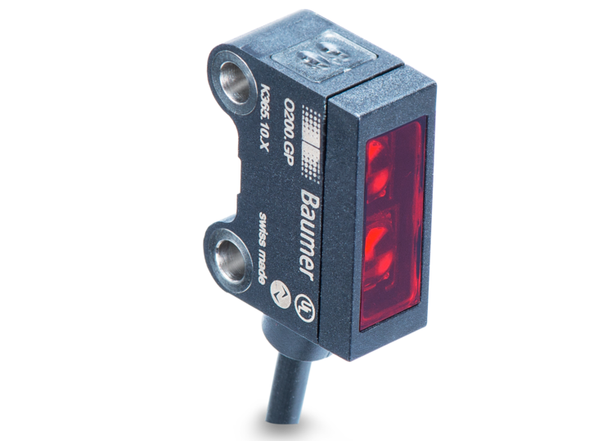




Why Engineers?
Five technology trends have changed the game for engineers.
The Cloud
Cheap Sensors
Artificial
Intelligence
Big Data
The Internet
Of Things

Slide 48
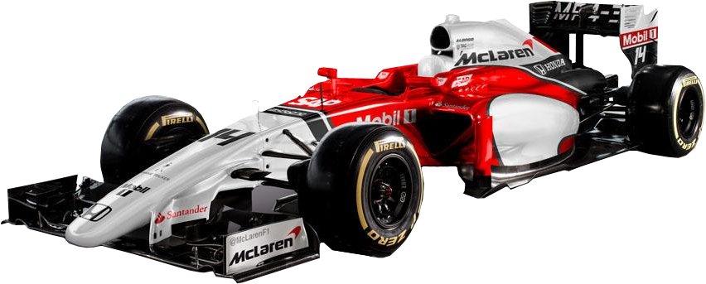
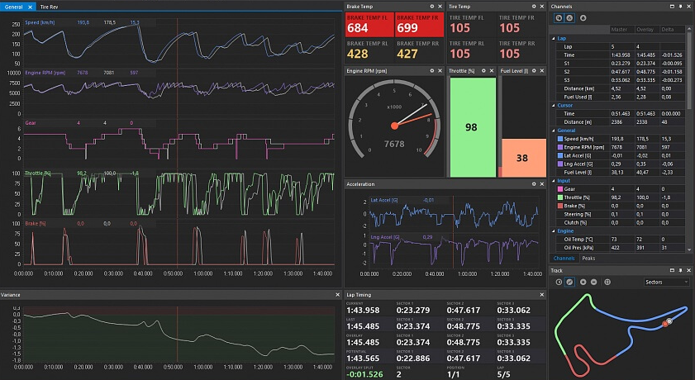
Mechanical Engineers
Realtime Diagnostics & Tuning

Slide 49
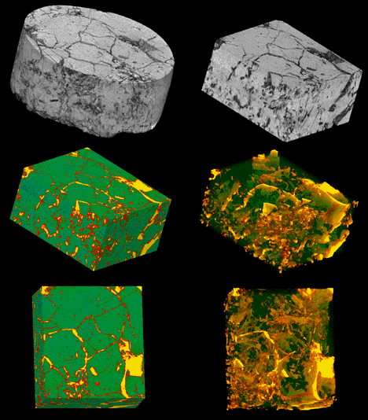
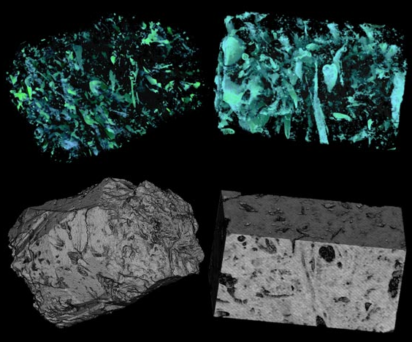
Materials Engineers
Digital Image Analysis of Material Microstructure

Slide 50
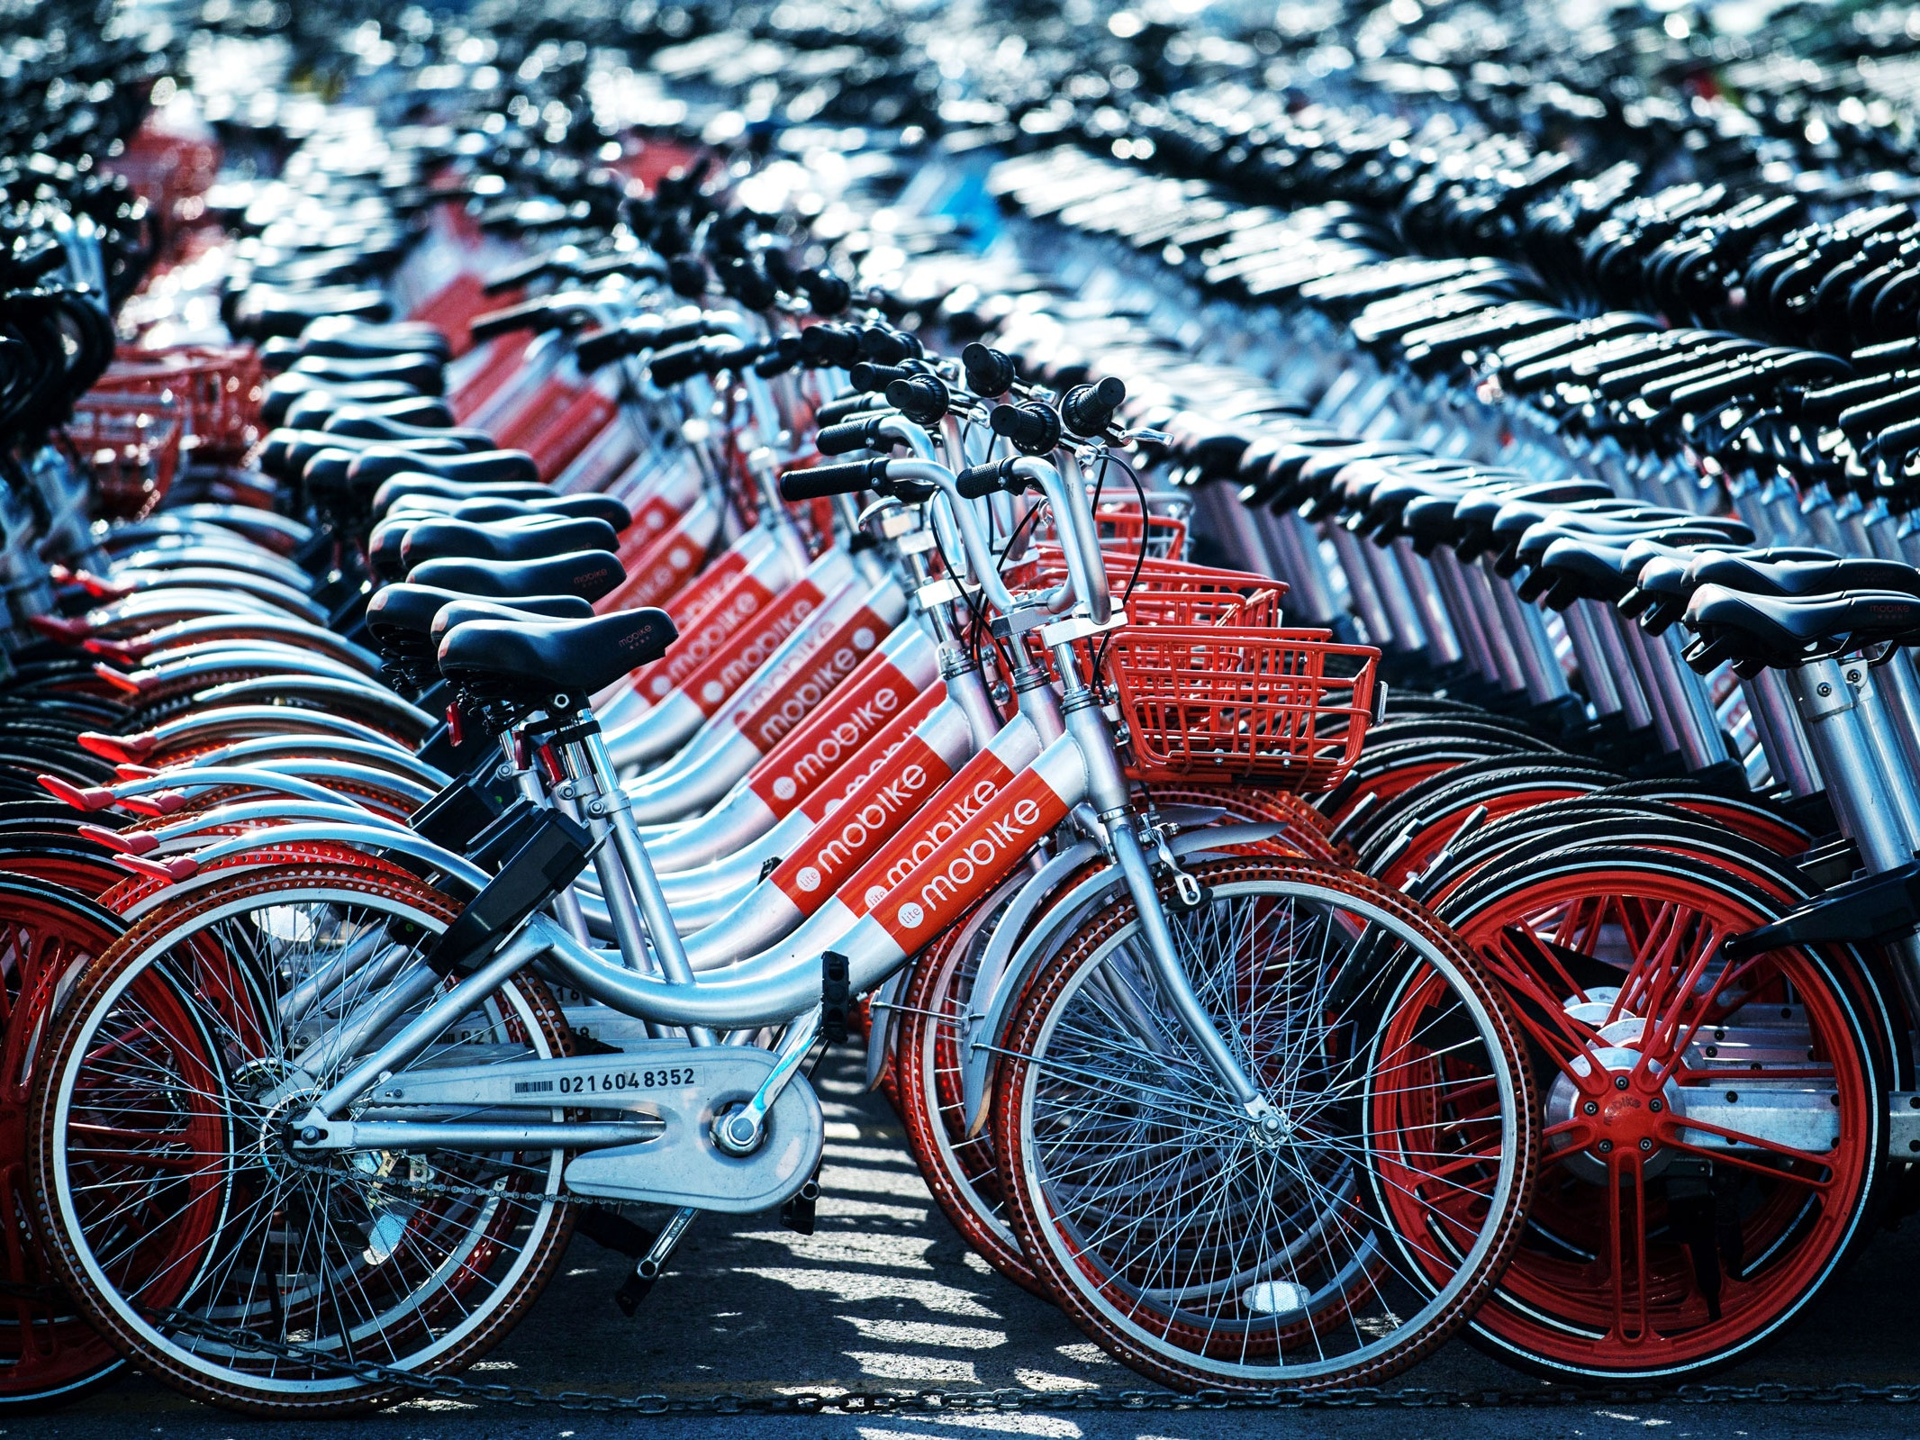

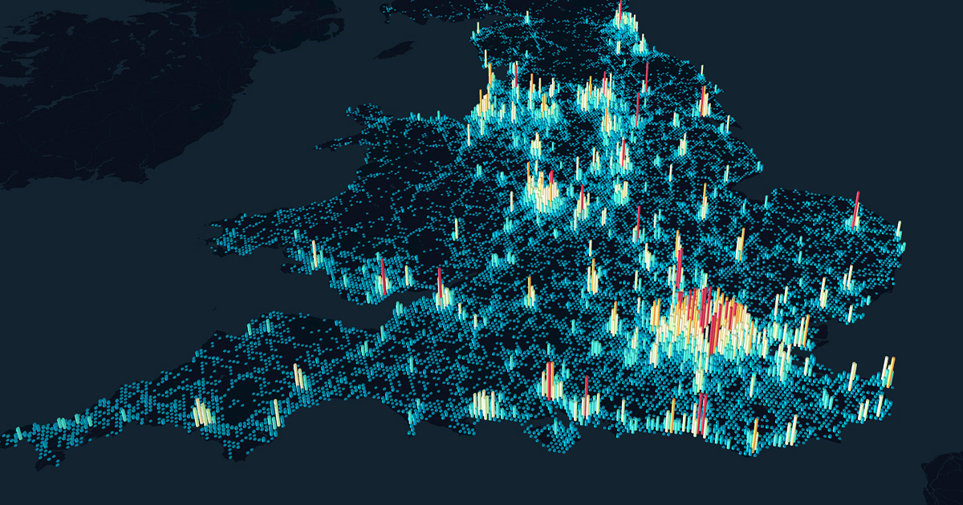
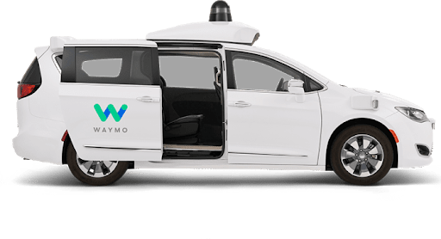
Civil Engineers
Urban Transportation Disrupted

Slide 51
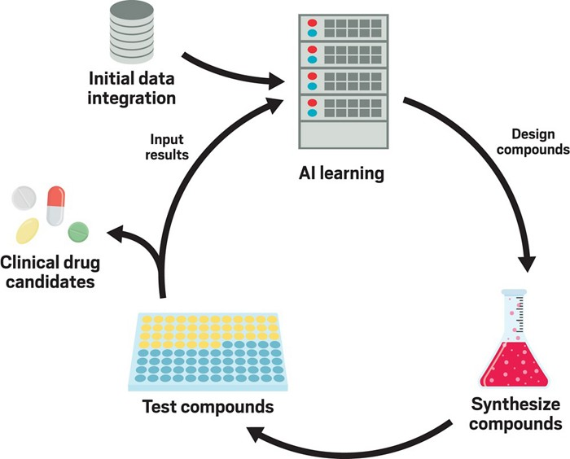
Chemical Engineers
Synthesizing new compounds

Slide 52


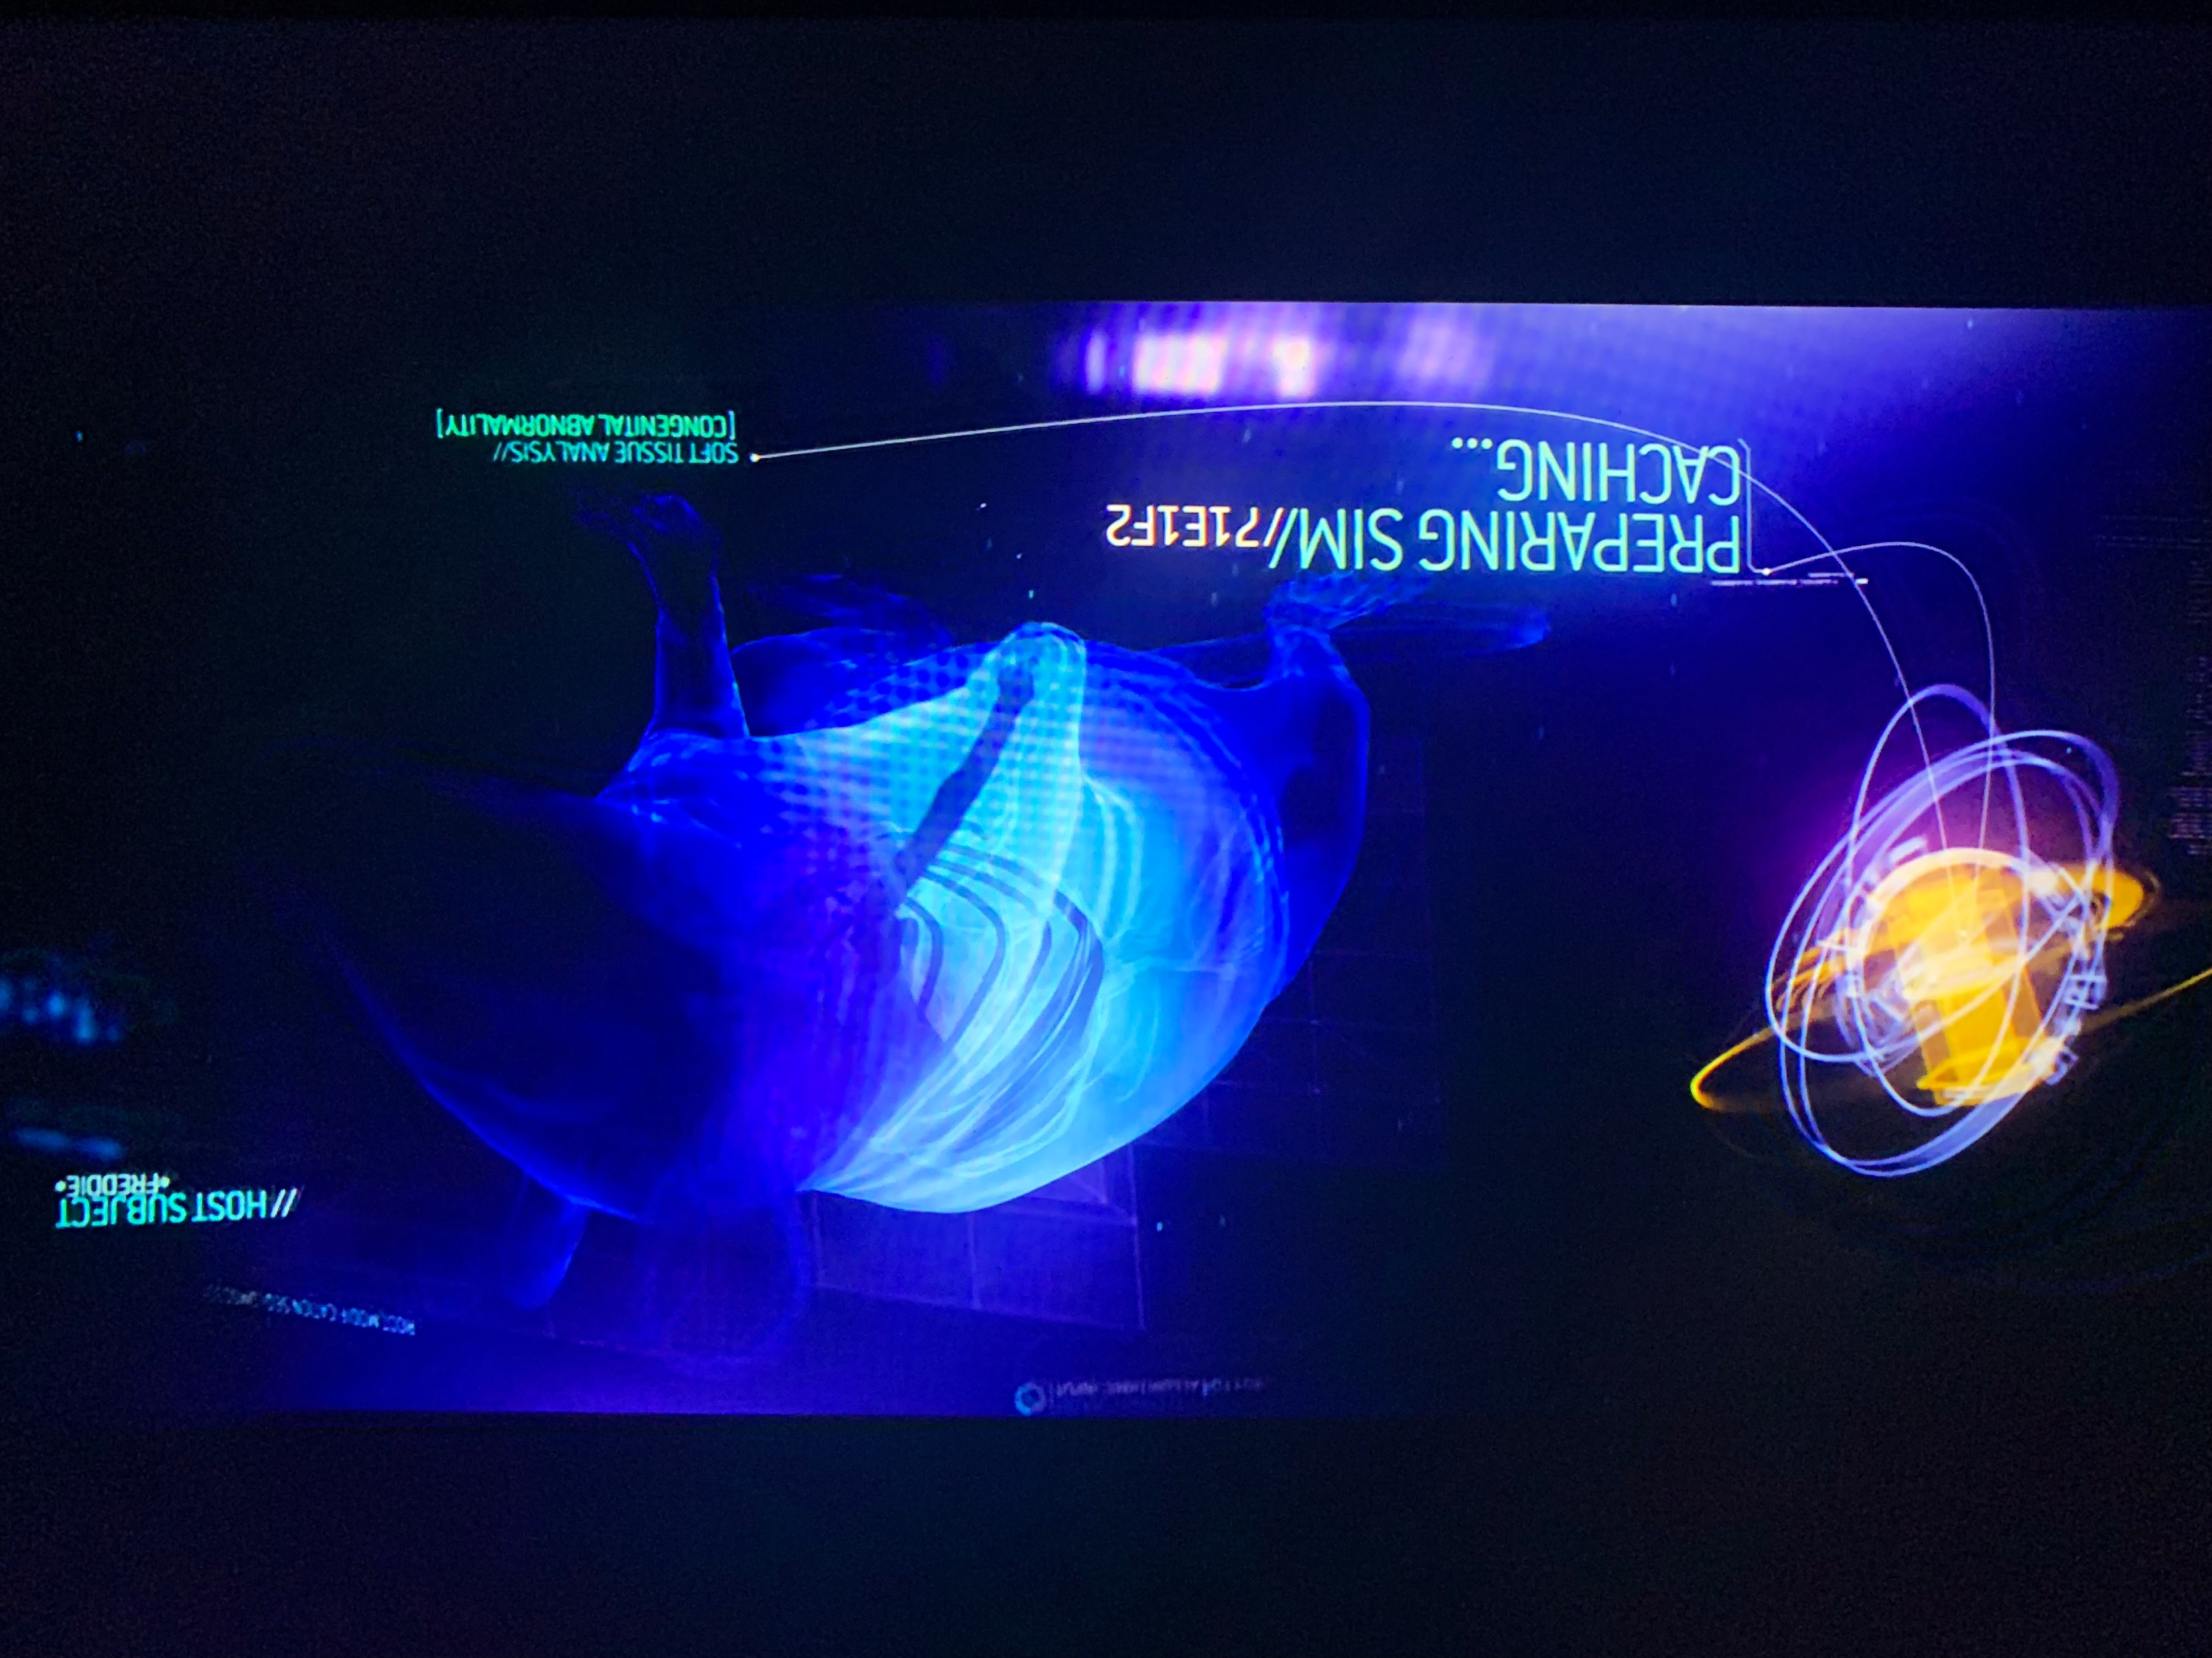
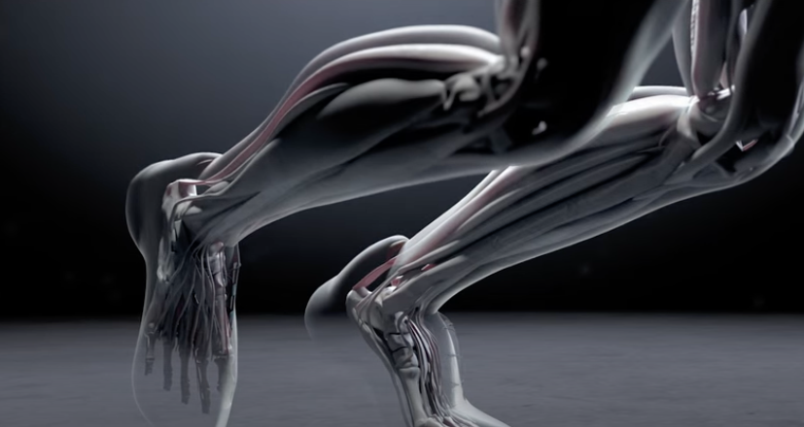
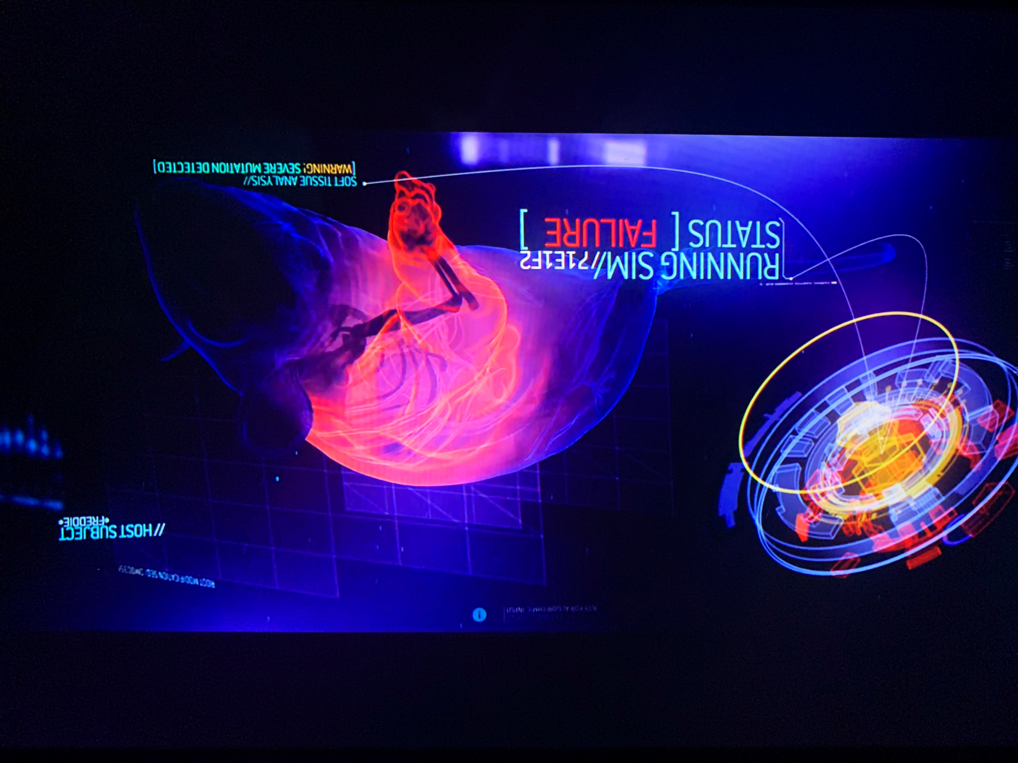
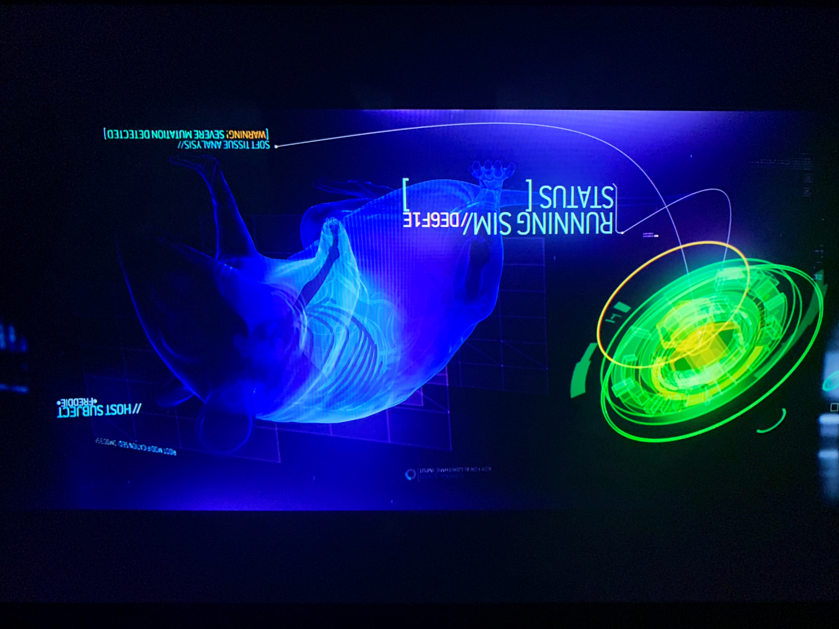
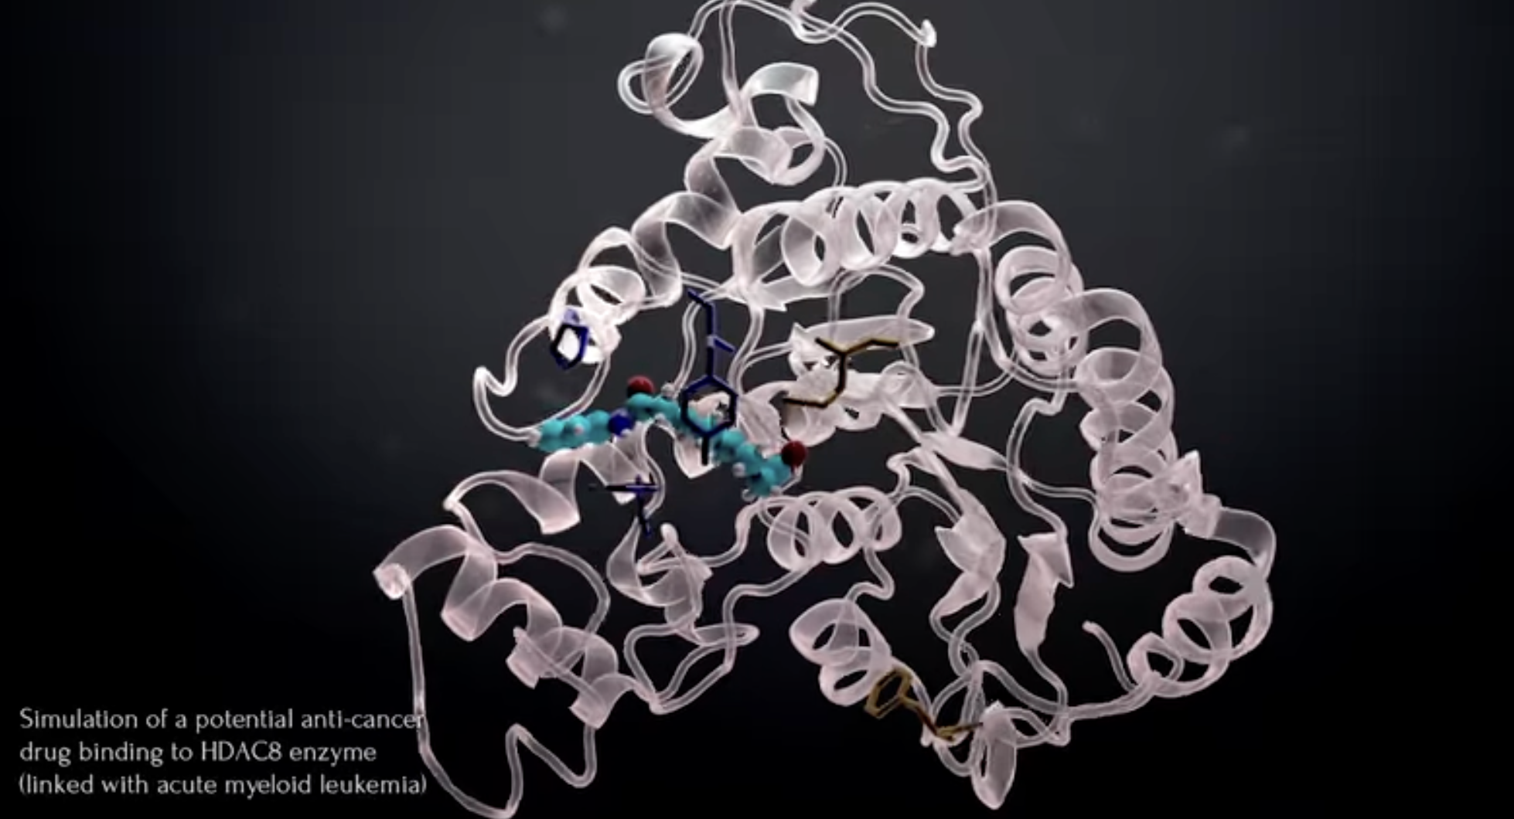
Sci-fi Inspiration

Slide 53



Mineral Engineers
Semi-Autonomous Mines

Slide 54
Programming Skills Are In Demand
According to the Developer Survey by StackOverflow, Python was one of the most in-demand technologies of 2018, 2019, 2020, and 2021.
As of 2021, it is ranked as the world’s 2nd most popular programming language among professional software developers as well as the first most wanted programming language.

Slide 55

One of the reasons for choosing Engineering!
Finally! A course that isn’t Chem, Bio, Physics, or Math
This (as well as your engineering design course) is what separates you from many other sciences
And makes you MUCH more valuable….

Slide 56
introduction.
Week 1 | Lecture 1 (1.1)

